Slide 1

WEEK 01
Instructor: Yanan Wu
TA: Vanchy Li
Spring 2025

Slide 2
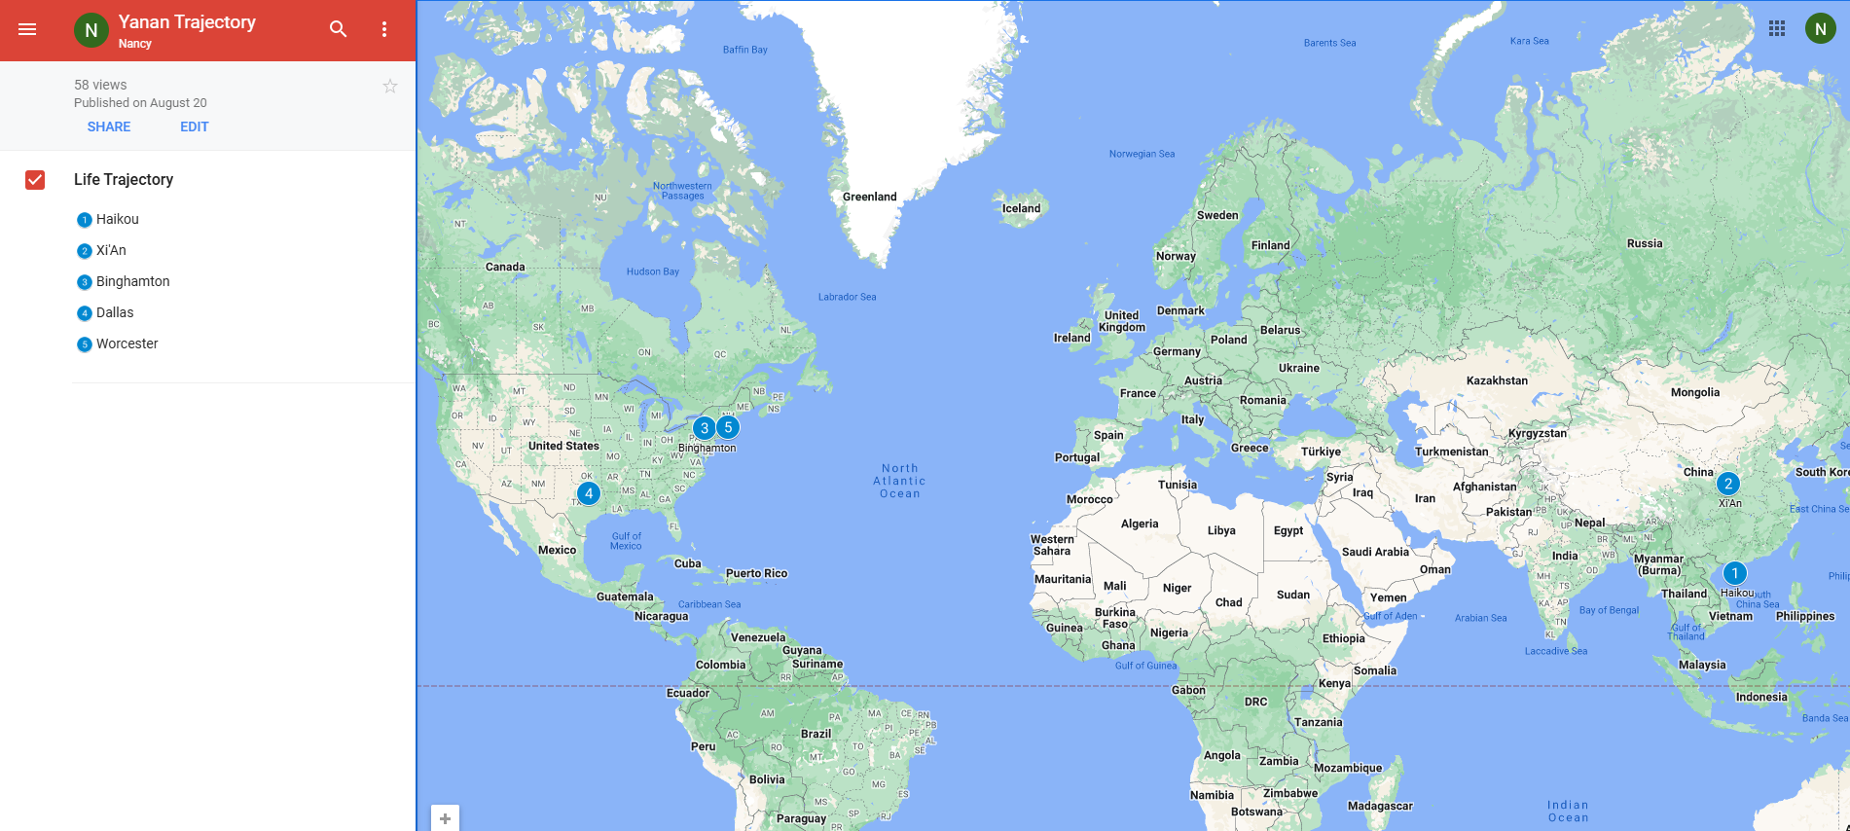
Yanan wu – visiting assistant professor
Education & Experience

Slide 3






Python Programming
Spatial Database
Intermediate Statistics
Manipulating Spatial Data
Web Mapping
Processing Raster
Data Analysis
Creating Custom Tool
Data Visualization
…
Geodatabase
SQL
Proximity Analysis
Geometry processing
Raster processing
PostSQL with python
…
Bivariate regression
Logistics regression
PCA
GWR
Spatial Autocorrelation
…

Slide 4
Instructor office hour
Tuesday & Thursday
1:30 pm – 2: 30 pm
Or By appointment
Office Location: Jeff 220

Slide 5
Ta introduction
Office Hours: 1: 00 – 3:00 PM on Monday
Office Location: EROS, the first floor of the Geography Building.

Slide 6
How about you?
Your background (e.g., name, major, where you come from)
What is your funniest thing that happened during your winter break?
What relevant experience do you have with spatial database?
What are your expectations for this course?

Slide 7
Course format
Lectures: Instructor & TA
Location: Physics/Math BP310 & Jonas Clark Hall JC105
Time: 10:25 – 11:40 on Monday & 14:50 – 16:40 on Tuesday
Labs: TA
Location: Physics/Math BP310
Time: 10:25 – 11:40 on Friday

Slide 8
learning resource
Introduction to PostGIS
Welcome to PostGIS Book
Obe, R., & Hsu, L. S. (2021). PostGIS in action. Simon and Schuster.
Other Training Materials
Official Manual about PostGIS

Slide 9
Course requirements
Labs: 9 labs in total
For any graded assignment, if the you do not agree with the grade received, the instructor and TA must be notified within one week after the assignment is graded.
Late policy for lab
One final project (oral presentation and paper report)

Slide 10
gRADE
Assignments 80% = nine labs
Final Project 20% = 15% oral + 5% written
A (93.0 to 100.0) | B (83.0 to 86.9) | C (73.0 to 76.9) | D (63.0 to 66.9)
A- (90.0 to 92.9) | B- (80.0 to 82.9) | C- (70.0 to 72.9) | D- (60.0 to 62.9)
B+ (87.0 to 89.9) | C+ (77.0 to 77.9) | D+ (67.0 to 69.9) | F (0.0 to 59.9)

Slide 11
Important dates
Jan 22. Add/Drop ends (& last day to request audit) Full Semester
No class
Jan 20. University holiday
Feb 17. Wellness day
March 3-7 Spring Break
March 24-27 AAG Conference
Final project
April 14-24 Working on final project
April 28 – May 1 Final project presentation
May 5 Final report due

Slide 12




COURSE WEBSITEs ON GITHUB
Intermediate Statistics
Spatial Database
Python Programming
Web Mapping

Slide 13
WEEK 01 lecture session
Instructor: Yanan Wu
TA: Vanchy Li
Spring 2025

Slide 14

Week 01
Introduction to the Course
Software Installation
PostgreSQL: The world’s most advanced open source database
PostGIS: About PostGIS

Slide 15

Week 02
Introduction to the PostGIS, PostgreSQL, and pgAdmin
Basic operations in pgAdmin
Introducing PostGIS
Introduction to psql

Slide 16
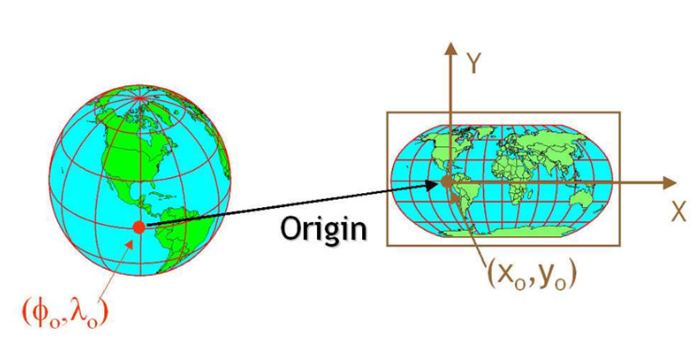
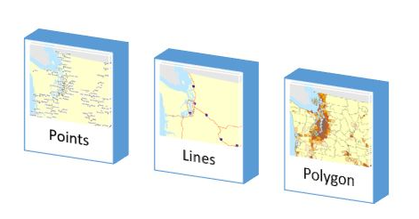
Week 03
Spatial data and geodatabases
Spatial data types
Spatial reference systems
Working with real data

Slide 17

Week 04
Introduction to SQL (It is pronounced as “Escuel “, but most often you can hear the slang “Sequel”.)
Simple SQL
SELECT
INSERT
UPDATE
DELETE
Working with spatial data

Slide 18
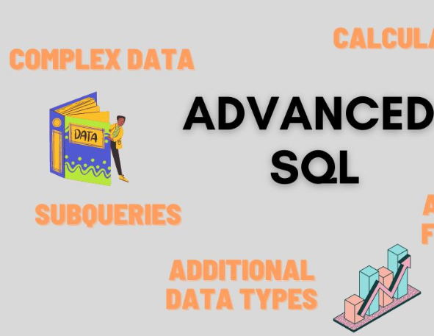
WEEK 05
Complex Queries and Database Management
Combine Information
Write Queries to run faster and use less data

Slide 19
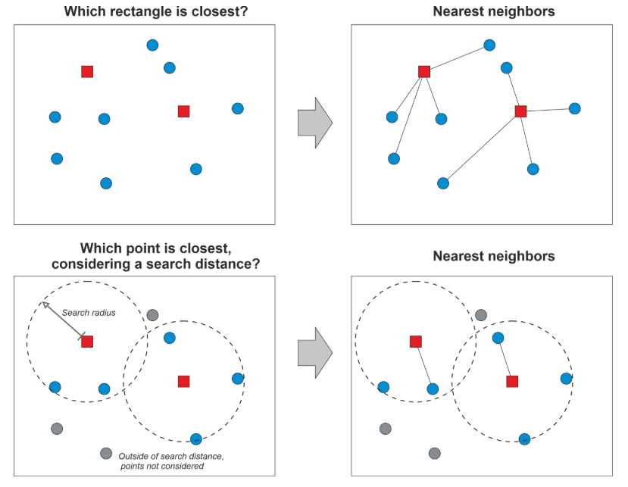
Week 06 & week 07
Proximity Analysis
Nearest Neighbor Search

Slide 20

WEEK 08
No Class Meeting
Spring Break

Slide 21
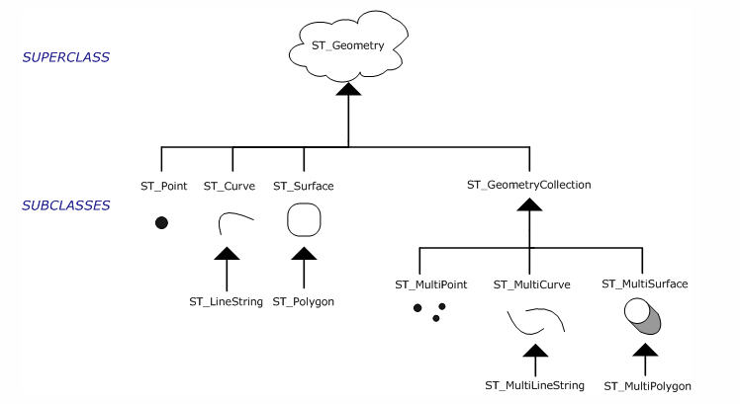
Week 09
Geometry processing

Slide 22
Week 10
Raster Processing
Raster output
Raster Accessors and setters
Reclassing functions

Slide 23

Week 11

Slide 24



Week 12
PostgreSQL and ArcGIS or QGIS

Slide 25

WEEK 13
PostGIS with Python
Week 14
PostGIS in Web Application

